Slide 1
Team3
Project report2019

Slide 2
Case Study
The Average Nigerian Life
A Survey Carried out on the Nigerian Population to ascertain the status of an average Nigerian and the status of Nigeria as Country.

Slide 3
Team Members
Adetayo Anuoluwapo
Kolawole Kushimo
Bankole Fisayo
Dipeolu Olayide
Chalokwu Nneamaka
Omokanye Samuel Oladeji
Ajulo Oluwadamilola

Slide 4
Overview
Nigeria, a country with a population 186 million people, is often referred to as the "Giant of Africa"
Nigeria owns this title because the following:
It is/was the most populous country in Africa.
It is/was home to the sixth largest urban center in the world.
It is/was the country the biggest economy in Africa.
Today, this is not the case, citizens and foreigners doubt and challenge this title with some facts. Some say poverty is high, some say leadership is bad, some say the citizens are barbarians.
You are a data scientist and you want to understand the life of Nigerians. You want to question the Nigerian economy and lifestyle and proffer solution based on data
You are presented with results from a survey to analyze. This data reflects the life of some Nigerians. This data may/may not be sufficient; and therefore might need information from other sources.
Do your job as a data scientist

Slide 5
Main features
Occupation
Source of income(primary or other).
Age group.
Largest form of expenses.

Slide 6
Goal
As Data Scientist, to be able to analyse Big Data.
To use this data to ascertain that current status of Nigeria(otherwise known as ‘Giant of Africa’)as a country, and the status of an average Nigerian.

Slide 7
Strategy
Get the data.
Analyze, sort and clean the data.
Visualize and get insights from the data.

Slide 8
Tools
Jupyter Notebook/ colab
GitHub

Slide 9
Survey
Demographics
Insights
Pain points
Acknowledgements

Slide 10
Survey
A survey was carried out and the following questions were asked:
Are you a Nigerian?
Gender
Age group
Are you married?
Do you have kids?
Where do you live?
What part of the state do you live in?
What is your occupation?
Are you happy with your job?
Do you think it is enough for you and your family?

Slide 11
Survey Cont’d
What are your other sources of income?
Do you pay taxes?
What is your largest form of expense?
What would you like to own?
How much do you earn from your other sources of income in a month?
How much do you spend on an average in a month?
Do you think Nigeria can get better?
Describe your Government in a short sentence?

Slide 12
QUICK QUESTION
As a Nigerian, what do you think is the most popular occupation?

Slide 13
Demographics
From the survey carried out, there was a total number of 303 entries and the following statistics shows the number of people with an occupation in Nigeria and their occupations:
Software Engineering /Computer Design 50
Student 48
Engineering 31
Entrepreneur 28
Financial Services 27
No Job 25
Student and Working 23
Others 18
Business 16
Consultant 16
Health 10
I don’t know 9
Farmer 1

Slide 14
Quick One
What is the one thing you think an Average Nigerian would love to own?

Slide 15
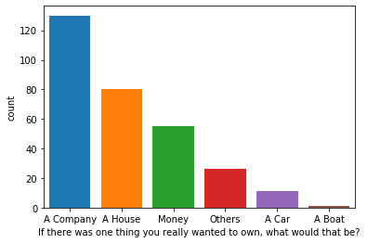

Slide 16
Demographics
From the survey, we were able to deduce the following statistics as to what nigerians would love to own:
A Company 130
A House 80
Money 55
Others 26
A Car 11
A Boat 1

Slide 17
Quick One
What do you think is the largest form of expense for an Average Nigerian?

Slide 18
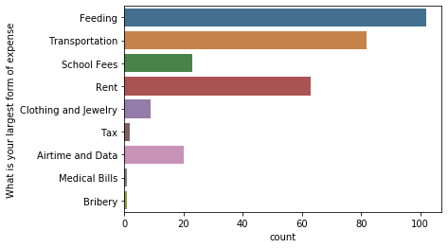

Slide 19
Demographics
The survey also showed a statistics of Nigerians largest form of expenses as thus:
Feeding 102
Transportation 82
Rent 63
School Fees 23
Airtime and Data 20
Clothing and Jewelry 9
Tax 2
Medical Bills 1
Bribery 1

Slide 20
Quick Question
How well do we embrace other sources of income in Nigeria?

Slide 21
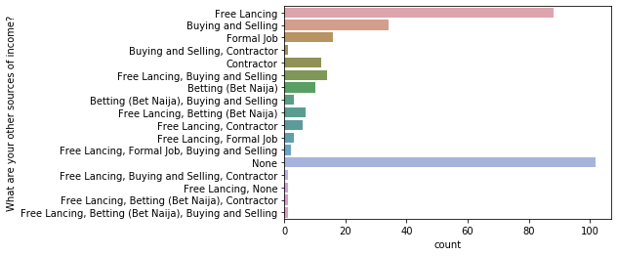

Slide 22
Demographics
From the survey, the following statistics was drawn:
None 102
Free Lancing 88
Buying and Selling 34
Formal Job 16
Free Lancing, Buying and Selling 14
Contractor 12
Betting (Bet Naija) 10
Free Lancing, Betting (Bet Naija) 7
Free Lancing, Contractor 6
Betting (Bet Naija), Buying and Selling 3
Free Lancing, Formal Job 3
Free Lancing, Formal Job, Buying and Selling 2
Free Lancing, Buying and Selling, Contractor 1
Free Lancing, Betting (Bet Naija), Contractor 1
Free Lancing, Betting (Bet Naija), Buying and Selling 1
Buying and Selling, Contractor 1
Free Lancing, None 1

Slide 23
Insights
From our survey, we were able to draw the following insights:
A greater percentage of the Nigerian population in this data is geared towards software engineering occupation.
The largest form of expense in Nigeria is feeding.
72% of the respondents that are students earn below N80,000.00.
Over 90% of finance guys are Big earners with income ranging between 110k and above and just 3 of them earn below 50k.
The relationship between job satisfaction and income satisfaction is relative to a number of factors like; Job role/description, work culture, location, benefits and who you work for, etc.

Slide 24
Insights
out of 303 entries, 27 of the respondents are financial service providers and 17 out of this 27 people are satisfied with their jobs. Sadly, only 5 out of the 27 people thinks the money is enough for their family sustenance.
> Sadly, out of 31 persons who identified their occupation as Engineering, only 15 are satisfied with their jobs. Only 4 out 0f this number are satisfied with their income.
> 28 out of the occupation entries are Entrepreneurs, 21 of them are satisfied with their jobs but none of them is satisfied with their income.
> Out of 16 entries as Business personnels, 11 of them are satisfied with their job and only one person is satisfied with the income(i.e it is sufficient to take care of the family.)
> 23 entries identified the occupation as student and working.15 of them are satisfied with their jobs, only one is satisfied with their income.

Slide 25
Pain points
Cleaning up such big data.
Analyzing the income range.
Visualizing data using Barchart.

Slide 26
Acknowledgements
Special thanks goes to the organizers AI Saturdays for this great opportunity to learn from the wonderful mentors that have mentored us thus far. We appreciate your time, effort and patience towards us.
Special thanks to Team3 members for their energy, time and cooperation, and to Team3 lead mentors for their guidance.

Slide 27


Slide 28
Resources
The following articles where helpful during our findings
The life expectancy for countries [source]
Most paid job in Nigeria[source]
Look up our notebook at : GitHub

